Slide 1
Grab All
Real Time Advertising Application

Slide 2
LOCATION BASED SERVICES
A location-based service (LBS) is a general term denoting software services which utilize geographic data and information to provide services or information to users.
It is also used to find out the persons or objects location, such as discovering about a restaurant or a grocery shop or a mall. LBS have two major actions, that is: Obtaining users location Provide and providing a service by utilizing this information.
LBS can provide with information such as : ‘Where the user is ?’ , ‘Where is this place?’ , ‘How to reach the nearest place ?’ etc.

Slide 3
PURPOSE
Due to increase in online shopping the business of the local vendors has declined to a greater extent.
One of the main reason why the online shopping got the boost is that, the people didn’t knew from which shop to buy their desired item.
The aim of this project is to develop a run-time advertiser android application for the upliftment of the business of local vendors and shopkeepers.
It focus on bridging the gap between the customer and the vendor.

Slide 4
ABOUT THE APPLICATION
Grab All is an android application using Location Based Services (LBS).
Here the user (customer) can view offers from the various nearby shops using this application.
Once the user registers and logs in into the application it can set a specific range, then the offers of registered shops in that set range can be seen by the user.
User can also view the categories of vendors who have registered there offers in the application.

Slide 5
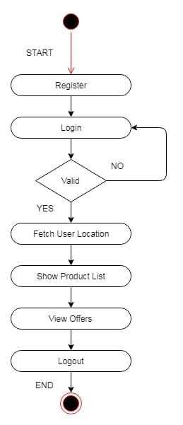
METHODOLOGY

Slide 6
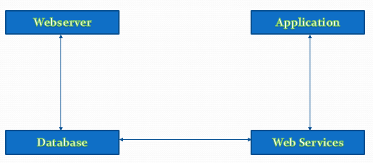
Architecture

Slide 7
Architecture
Web services are followed by contact between the mobile client and the server-hosted website. A structured HTTP application layer protocol GET method request is sent to the API by the smartphone application which takes the arguments and instructions.
The API connects to the database and queries the data required based on the arguments received.
The API compiles an answer in the form of a standardized set of elements based on those instructions and arguments. Such elements contain information that the mobile application requires to show a list of locations which can be checked in more detail by the user.
The diagram shown in previous slide Exemplifies a simplified definition of communication between our website and the smartphone app using web services.
The diagram's server side represents a database abstraction, with a bidirectional relation between the API program and the database.

Slide 8
TECHNOLOGY
Android - Android is the main open source versatile application stage that in different markets can possibly make significant advances. Android has solid APIs, dependable documentation, and no expense of creation or conveyance. In Android, all applications have equivalent standing. Outsider and local Android applications are composed utilizing a similar APIs and are executed on a similar run time.
Global Positioning System (GPS) – GPS is a radio navigation system that allows people on land, sea, or air users to determine their exact location, velocity, and time 24 hours a day, in all weather conditions, anywhere in the world. GPS takes help from GPRS and now and again, to stick point the present area precisely.
MySQL - MySQL is a Relational Database Management System (RDBMS) that runs as a server giving multi-client access to various databases. SQL was first evolved to work on information in databases that follow the social model. It is a programming language for questioning, altering and overseeing information. MySQL is the most well-known open source database apparatus. It is viewed as a simple and solid program contrasted with other database programming. MySQL offers different various projects that are database related.

Slide 9
TECHNOLOGY
PHP (PHP - Hypertext Pre-processor) - PHP (PHP - Hypertext Pre-processor) is a specific scripting language, principally utilized for the advancement of dynamic site pages. Its key job is powerfully producing HTML code, yet it has numerous different applications. By utilizing PHP, it is possible to make a HTML page with progressive dynamic and organized substance.
Web Services - Web services innovation is changing the Internet, expanding with abilities to create the value-based web. This change is being powered by the program to program correspondence model of Web administrations based on existing and rising norms, for example, Hyper Text Transfer Protocol (HTTP), Extensible Markup Language (XML) etc. .

Slide 10
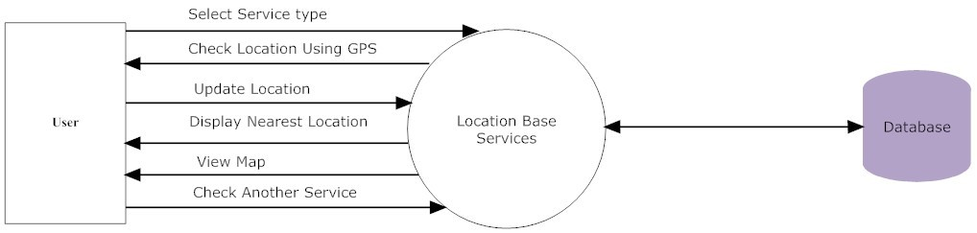
Client or user side process utilizing location based services
The User chooses the reliable service type i.e. Location Based Services. Location Based Services uses GPS to search positions. The Server Location Based Services stores the location. The Location Based Services changes the location in the database when the user is traveling or changing location. Whenever the user opens the tab, the Location Based Services will show the user the nearest location. The user checks for other services provided by the Location Based Services.

Slide 11
conclusion
In this paper we shown what is Location Based Services(LBS) and how it can be used to solve the problem. Earlier the only use of mobile phone was voice communication, but now voice communication is just one aspect of a mobile phone. There are other major factors such as web browser and GPS services. With the consideration of these factors ‘Grab All’ is implemented. ‘Grab All’ helps to reduce the gap between the vendor and the customer by providing the vendors a platform to reach out to all the customers in the nearby area. Also it makes the task of the customer easy, as the customer can easily find out from whom to buy the desired product and who the vendors are and also the vendors location. Hence the business of the local vendors is enhanced and the customer service is made easy.

Slide 12
References
Sandeep Kumar, Mohammed Abdul Qadeer, Archana Gupta Department of Computer Engineering Zakir Hussain College of Engineering and Technology Aligarh Muslim University, Aligarh 202002, India
https://pigeon.srisys.com/blog/types-of-location-based-services
Choong C. Lee Graduate School of Information Yonsei University 50 Yonsei-ro, Seodaemun-gu, Seoul,120-749, Korea
Hongbing Wang, 1, 2, 3 Joshua Zhexue Huang, 3 Yuzhong Qu, 2 Junyuan Xie, 1 1 Department of Computer Science and Technology Nanjing University Nanjing 210093, China
Gartner, G.; Huang, H. Progress in Location-Based Services 2016; Lecture Notes in Geoinformation and Cartography; Springer: Berlin/Heidelberg, Germany, 2017.
CartouCHe, Stefan Steiniger, Moritz Neun, and Alistair Edwardes, "Foundations of Location Based Services," London, UK: SpringerVerlag, 304-307.
André Malm , Mobile Location-Based Services, 9th ed.: Berg Insight AB No.146 @ "http://www.reportlinker.com/p0203495/Mobile-LocationBased-Services-Edition.html", 2015.
Vladimir Lazović, Nikola Minić, Milan Tair Singidunum University, 32 Danijelova St., Belgrade, Serbia
Manav Singhal, Anupam Shukla, 1ABV-Indian Institute of Information Technology and Management Gwalior, India
https://www.engpaper.com/mysql-database-very-good-thesis.html

